Slide 1


Lecture 12:
The atomic nucleus
Modern physics
Dr. Szilvási Réka
Assistant professor
BME ttk NTI

Slide 2
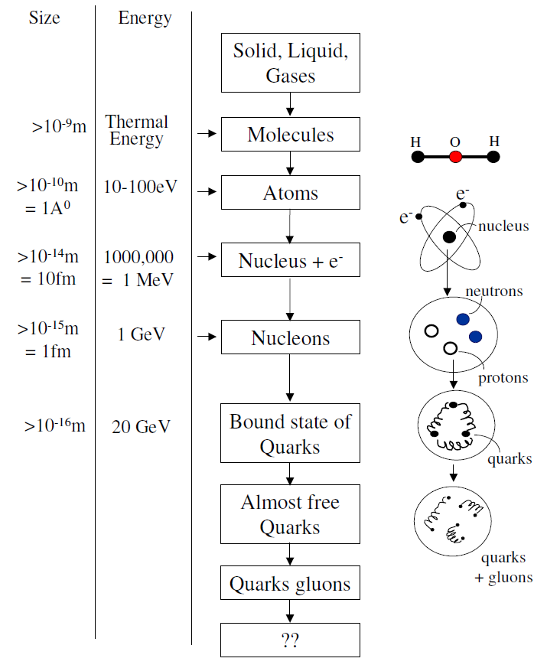
Constituents of matter at different distance and energy scales
1 eV=11600 K

Slide 3
Constituents of matter at different distance and energy scales
fermions
1 eV=11600 K

Slide 4
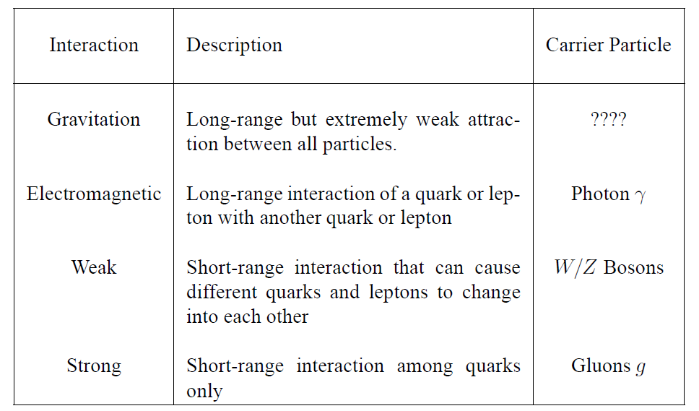
Basic forces of nature
bosons
1 eV=11600 K

Slide 5
Basic forces of nature
bosons
Nuclear and particle physics
1 eV=11600 K

Slide 6
Nuclear physics
1 eV=11600 K

Slide 7
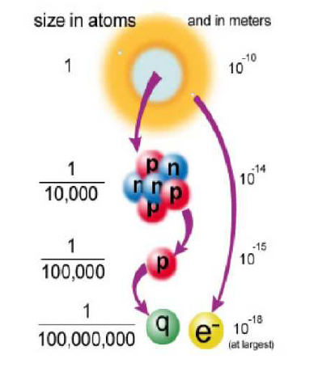
Nuclear physics
1 eV=11600 K
Notes:
At thsese different energy scales different forces start to dominate

Slide 8
What is nuclear physics?
Nuclear force
Structure of nuclei
How nuclei interact
High-energy nuclear physics
Low-energy nuclear physics
Heavy-ion collisions, quark-gluon plasma
e.g nucleosynthesis

Slide 9
The birth of nuclear physics
discovery of the atomic nucleus, the neutron
Notes:
How it all started?

Slide 10
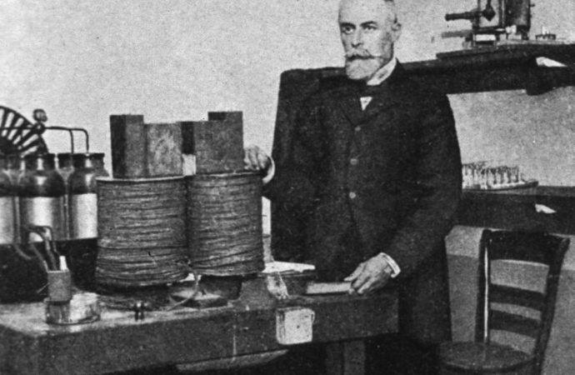
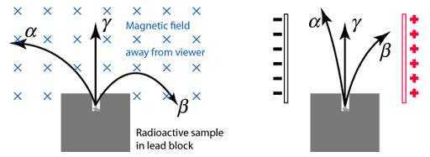
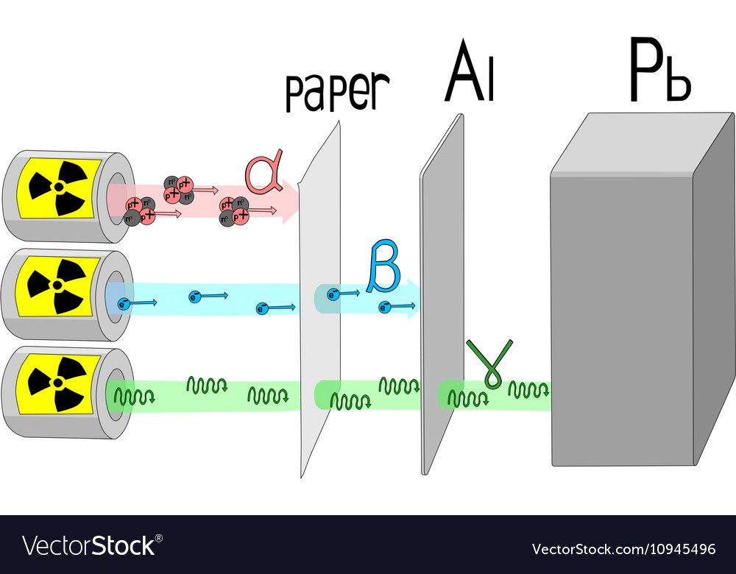
Discovery of radioactivity
Henri Becquerel
1896, Becquerel: radiation emitted from uranium
1897, Thomson: discovery of the electron
early 1900s: differentiate the three types of emitted particles by their:
  charge/mass ratio: how an external electric and magnetic field deflect the particles
  penetrating power: entirely different nature of the particles
α – particles: heavy, He²⁺ ions
β – particles: high-energy electrons
γ - radiation: electromagnetic radiation (photons)

Slide 11
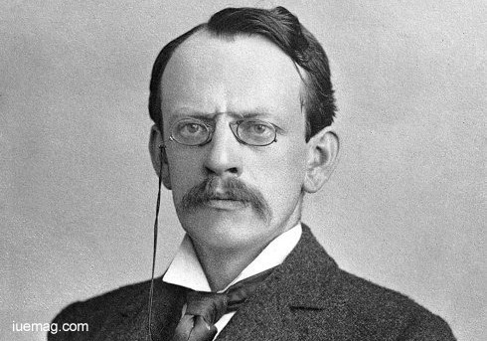
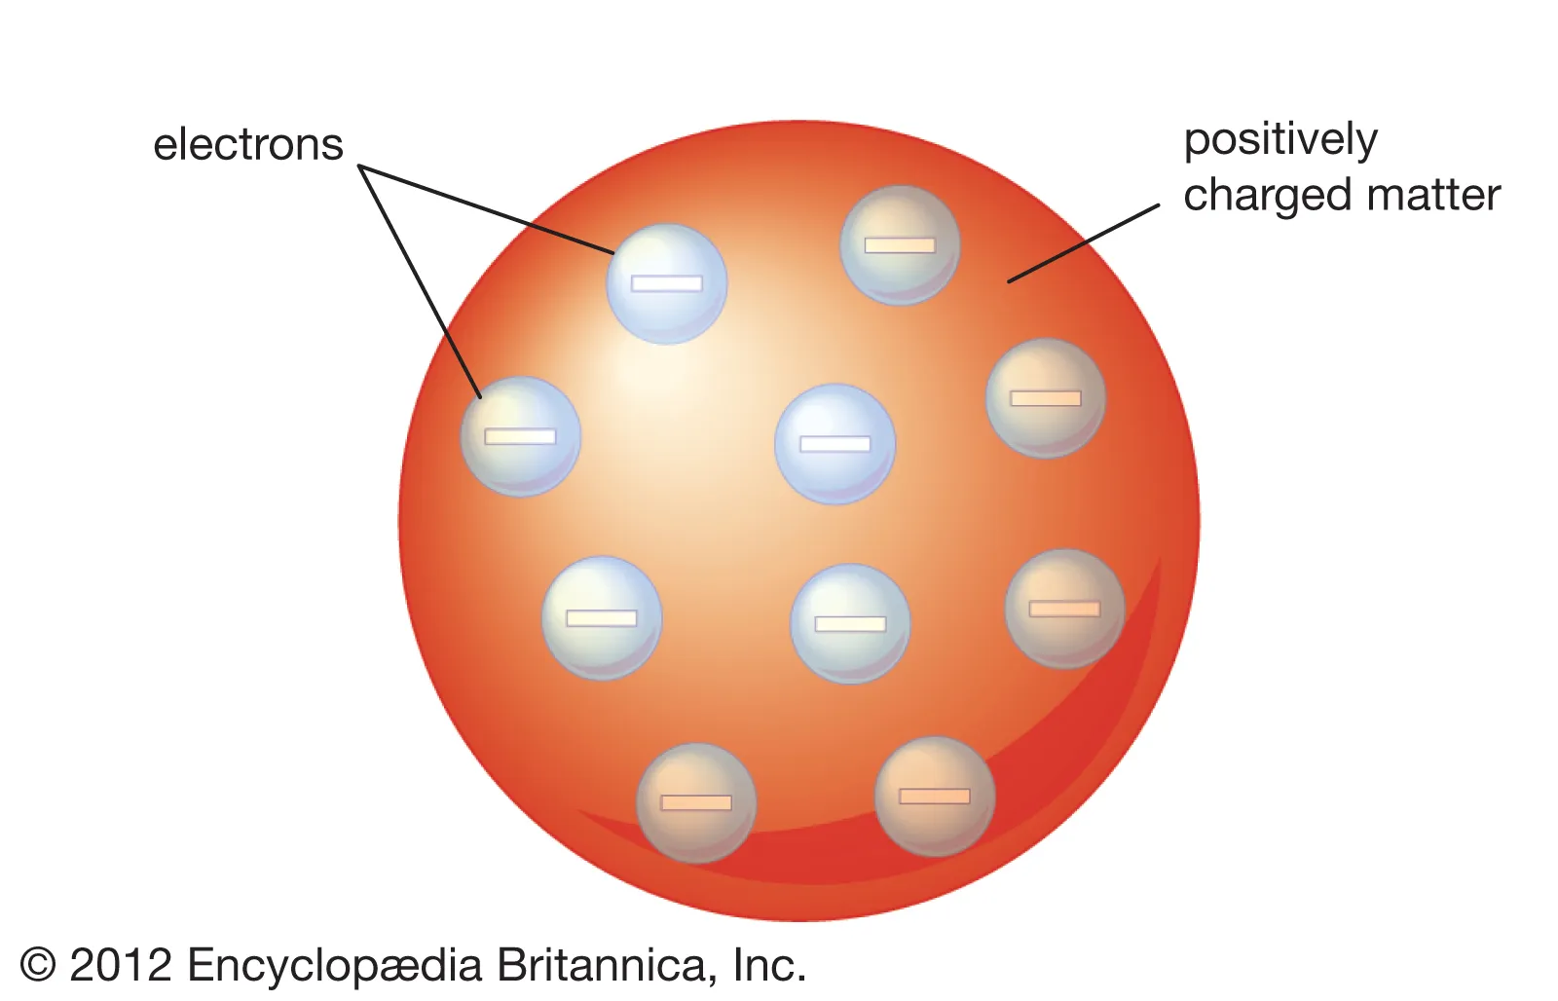
Thomson atomic model
Properties of the electron:
m_{e}=0,5109989461 ±0,0000000031 MeV/c²
q = -1e
Homogeneous charge distribution
Large portion of the mass belongs to the positively charged matter
|q/m_{e} | >> |q/M_{positive}|
electrically neutral

Slide 12
How alpha particles are absorbed by a sheet of paper when the atoms are neutral?

Slide 13

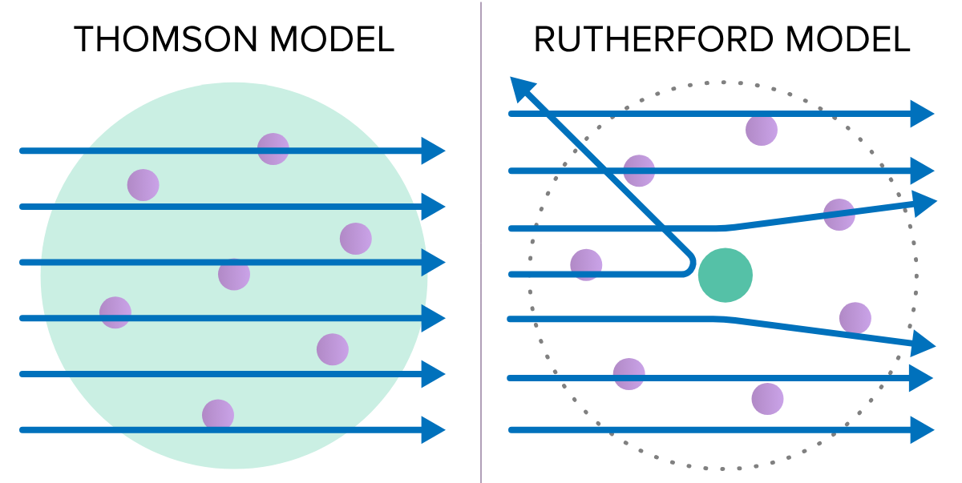
Rutherford’s experiment: the discovery of the nucleus
Maximal effect of alpha particle deflection
  Fully ionized atom (positive charge)
  Size of the atom: R≈10⁻¹⁰ m
  Estimate the maximum electric potential energy of the alpha particle (consider a spherically symmetric atom with uniform charge distribution)
Notes:
They could get flown away

Slide 14
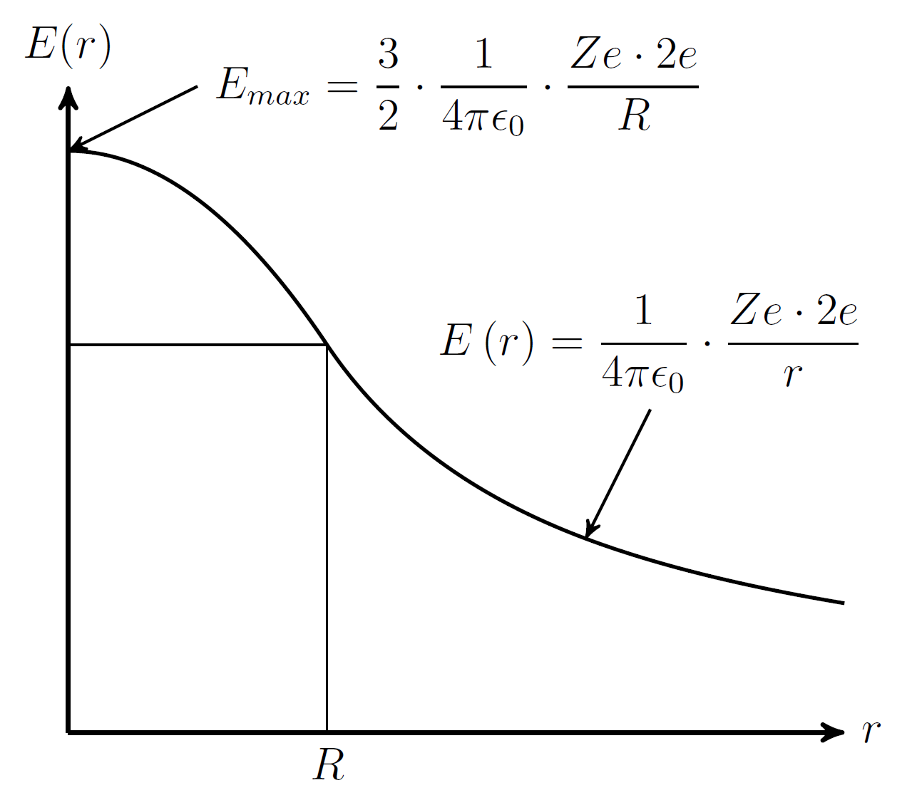
Rutherford’s experiment: the discovery of the nucleus
E_{alpha}~ 7700 ⋅10⁻¹⁶ J
Maximal effect of alpha particle deflection
  Fully ionized atom (positive charge)
  Size of the atom: R≈10⁻¹⁰ m
  Estimate the maximum electric potential energy of the alpha particle (consider a spherically symmetric atom with uniform charge distribution)

Slide 15
Rutherford’s experiment: the discovery of the nucleus
Z₁= 2 (atomic number of He)
Z₂= 79 (atomic number of Au)
E_{alpha}~ 7700 ⋅10⁻¹⁶ J
E_{max}~ 5,5 ⋅10⁻¹⁶ J
Maximal effect of alpha particle deflection
  Fully ionized atom (positive charge)
  Size of the atom: R≈10⁻¹⁰ m
  Estimate the maximum electric potential energy of the alpha particle (consider a spherically symmetric atom with uniform charge distribution)

Slide 16
Rutherford’s experiment: the discovery of the nucleus
E_{alpha}~ 7700 ⋅10⁻¹⁶ J
E_{max}~ 5,5 ⋅10⁻¹⁶ J
No back scattering is expected!

Slide 17
Rutherford’s experiment: the discovery of the nucleus
E_{alpha}~ 7700 ⋅10⁻¹⁶ J
E_{max}~ 5,5 ⋅10⁻¹⁶ J
No back scattering is expected!
Back scattering events were observed!

Slide 18
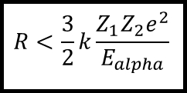
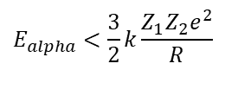
Rutherford’s experiment: the discovery of the nucleus
E_{alpha}~ 7700 ⋅10⁻¹⁶ J
E_{max}~ 5,5 ⋅10⁻¹⁶ J
No back scattering is expected!
Back scattering events were observed!
The positive charge and the mass must be confined in a small region of R
$$E_{alpha}<\frac{3}{2}k\frac{Z_{1}Z_{2}e^{2}}{R}$$
$$R<\frac{3}{2}k\frac{Z_{1}Z_{2}e^{2}}{E_{alpha}}$$
hence:

Slide 19
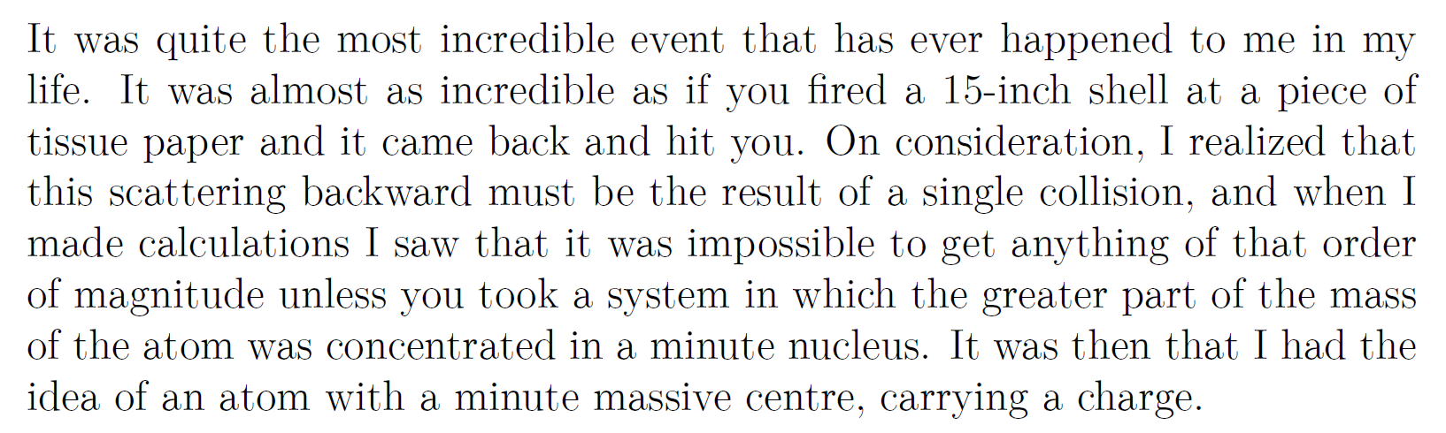
„
Ernest Rutherford on the discovery of back scattering events during their experiment with alpha particles scattering on gold atoms
Notes:
It was torture……. Why, it was worth it, we might conclude!

Slide 20
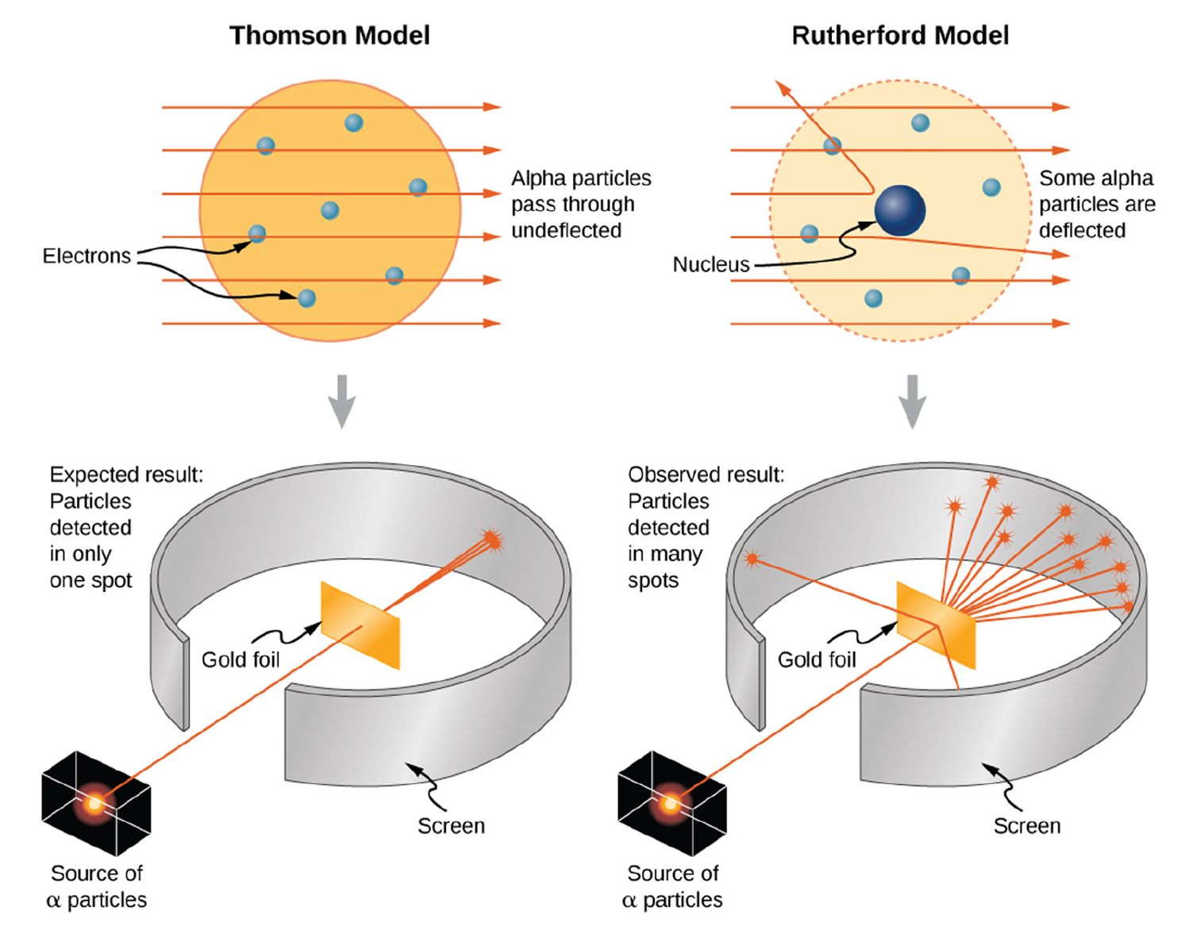
10.1515/phys-2023-0155

Slide 21
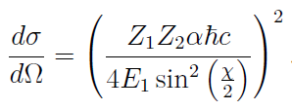
Rutherford’s experiment: analysis
Construct a model for the scattering process (that time: classical mechanics)
Calculate the differential cross section (can be measured): determine the scattering angle dependence, atomic number dependence, projectile kinetic energy dependence
Rutherford’s hypothesis of a nucleus:
Positive charge
For Z=79 large mass compared to the mass of the alpha particle
Appears point-like to the alpha particle
Notes:
Diff cross: shows us the angle distribution of the scattered particles

Slide 22
Rutherford’s experiment: analysis
Construct a model for the scattering process (that time: classical mechanics)
Calculate the differential cross section (can be measured): determine the scattering angle dependence, atomic number dependence, projectile kinetic energy dependence
Rutherford’s hypothesis of a nucleus:
Positive charge
For Z=79 large mass compared to the mass of the alpha particle
Appears point-like to the alpha particle
Luck: only true for spin-0 particles scattering on Coulomb potential…..

Slide 23
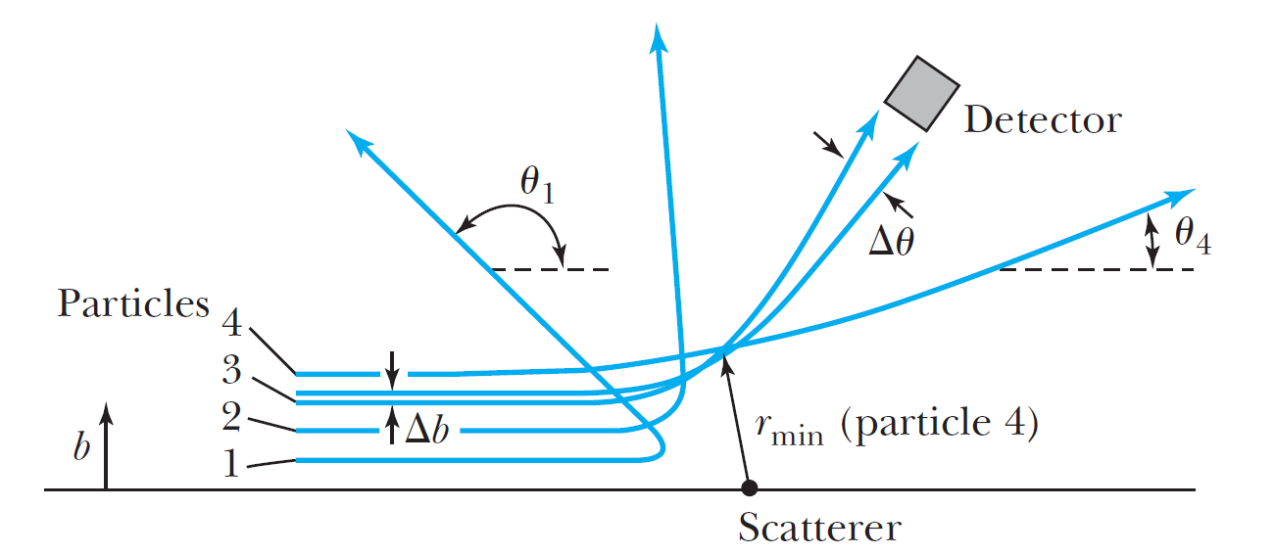



Rutherford’s experiment: analysis
Determine the radius of the charge distribution
Rutherford’s hypothesis of a nucleus:
Positive charge
For Z=79 large mass compared to the mass of the alpha particle
Appears point-like to the alpha particle
the closest the particle can get to the nucleus
and it still looks point-like!
$$r_{min}≅27 fm$$
$$→ R_{nuc}<27 fm$$

Slide 24

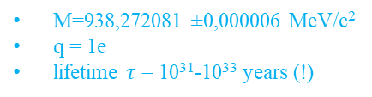
Discovery of the neutron, 1932
$$N^{14}+α→O^{17}+H(=p)$$
Rutherford discoverd the proton by the first nuclear reaction:
    What do we know about the proton?
The nucleus must contain Z protons (an atom has Z electrons) neutral atom
However, the mass of a nucleus is larger than Z*m_{p} ; approximately A*m_{p}, A≈2*Z
M=938,272081 ±0,000006 MeV/c²
q = 1e
lifetime $τ$ = 10³¹-10³³ years (!)
Notes:
Gamma photons: photons coming from the nucleus

Slide 25
Discovery of the neutron, 1932
$$N^{14}+α→O^{17}+H(=p)$$
Rutherford discoverd the proton by the first nuclear reaction:
    What do we know about the proton?
The nucleus must contain Z protons (an atom has Z electrons) neutral atom
However, the mass of a nucleus is larger than Z*m_{p} ; approximately A*m_{p}, A≈2*Z
Rutherford proposed the existence of a neutral particle inside the nucleus: neutron
    Could it be the bound state of a proton and an electron?
M=938,272081 ±0,000006 MeV/c²
q = 1e
lifetime $τ$ = 10³¹-10³³ years (!)
Notes:
Gamma photons: photons coming from the nucleus

Slide 26
Discovery of the neutron, 1932
$$N^{14}+α→O^{17}+H(=p)$$
Rutherford discoverd the proton by the first nuclear reaction:
    What do we know about the proton?
The nucleus must contain Z protons (an atom has Z electrons) neutral atom
However, the mass of a nucleus is larger than Z*m_{p} ; approximately A*m_{p}, A≈2*Z
Rutherford proposed the existence of a neutral particle inside the nucleus: neutron
    Could it be the bound state of a proton and an electron?
Interesting experiments: beryllium radiation (Bothe, Becker)?
    Penetrates a thick sheet of LEAD
    Neutral (gamma photons?)
    Creates protons from paraffin
M=938,272081 ±0,000006 MeV/c²
q = 1e
lifetime $τ$ = 10³¹-10³³ years (!)
Notes:
Gamma photons: photons coming from the nucleus

Slide 27
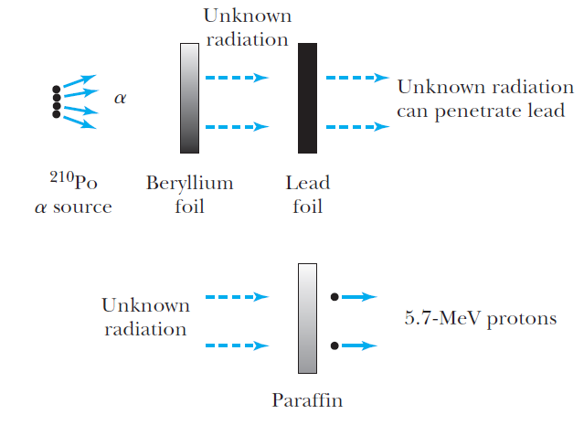
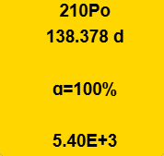
Could be the result of the Compton scattering of high-energy photons? How high energy? Around 50 MeV…….
Chadwick: a neutron with mass close to the proton mass (1932)
hydrocarbon

Slide 28
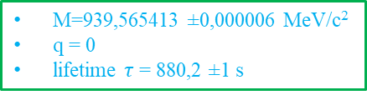

2p + 2n A=4, Z=2
$${}_{4}^{9}{Be}+α→{}_{6}^{12}C+n$$
neutron
M=939,565413 ±0,000006 MeV/c²
q = 0
lifetime $τ$ = 880,2 ±1 s
hydrocarbon

Slide 29

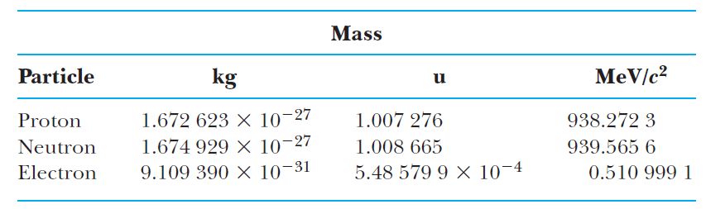
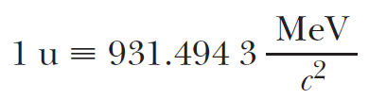

Constituents of the atomic nucleus
A=N+Z
Mass number
$${}_{Z}^{A}{X:}$$
nucleus (A,Z) = bound state of protons (Z) and neutrons (N)
Atomic number
atomic unit: m(¹²C)/12
atomic mass
Notes:
We love to equate it to 1

Slide 30
Constituents of the atomic nucleus
A=N+Z
Mass number
$${}_{Z}^{A}{X:}$$
nucleus (A,Z) = bound state of protons (Z) and neutrons (N)
Atomic number
atomic unit: m(¹²C)/12
atomic mass
Z
Isotopes: same Z, different A (one element)
Isobars: same A, different Z
Isotones: same N(=A-Z), different A and Z
N
Notes:
A,Z are used to describe the composition of nuclei

Slide 31
Constituents of the atomic nucleus
A=N+Z
Mass number
$${}_{Z}^{A}{X:}$$
nucleus (A,Z) = bound state of protons (Z) and neutrons (N)
Atomic number
What binds the nucleons? (protons repel each other due to the Coulomb force)
There must be a new type of interaction between the nucleons!
Introduce nuclear force, properties:
attractive (stronger than EM)
short-range (know from scattering experiments)

Slide 32
Basic (bulk) properties of nuclei
Charge density, charge and force radius, magnetic moment, nuclear spin

Slide 33
Nuclear charge density, charge radius
How to „look” inside the nucleus?

Slide 34

Nuclear charge density, charge radius
How to „look” inside the nucleus?
$${λ<R}_{nucleus}$$

Slide 35
Nuclear charge density, charge radius
How to „look” inside the nucleus?
$${λ<R}_{nucleus}$$
$$p>\frac{h}{R_{nucleus}}→pc>\frac{ℏc2π}{R_{nucleus}}≈\frac{197∙2π}{10}MeV=123 MeV$$

Slide 36
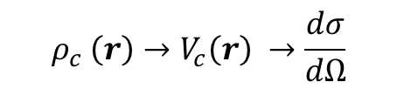
Nuclear charge density, charge radius
How to „look” inside the nucleus?
Determine the nuclear charge density
$${λ<R}_{nucleus}$$
$$p>\frac{h}{R_{nucleus}}→pc>\frac{ℏc2π}{R_{nucleus}}≈\frac{197∙2π}{10}MeV=123 MeV$$
$${ρ_{c} \left(r\right)→V}_{c}\left(r\right) →\frac{dσ}{dΩ}$$

Slide 37
Nuclear charge density, charge radius
How to „look” inside the nucleus?
Determine the nuclear charge density
$${λ<R}_{nucleus}$$
$$p>\frac{h}{R_{nucleus}}→pc>\frac{ℏc2π}{R_{nucleus}}≈\frac{197∙2π}{10}MeV=123 MeV$$
$${ρ_{c} \left(r\right)→V}_{c}\left(r\right) →\frac{dσ}{dΩ}$$
High-energy alpha particle is not suitable: alpha particle experiences the nuclear force upon approaching the nuclear surface anomalous scattering
Notes:
Which particle is suitable for this?

Slide 38
Nuclear charge density, charge radius
How to „look” inside the nucleus?
Determine the nuclear charge density
$${λ<R}_{nucleus}$$
$$p>\frac{h}{R_{nucleus}}→pc>\frac{ℏc2π}{R_{nucleus}}≈\frac{197∙2π}{10}MeV=123 MeV$$
High-energy electron scattering!
$${ρ_{c} \left(r\right)→V}_{c}\left(r\right) →\frac{dσ}{dΩ}$$
High-energy alpha particle is not suitable: alpha particle experiences the nuclear force upon approaching the nuclear surface anomalous scattering
Relativistic electron scattering on Coulomb potential

Slide 39
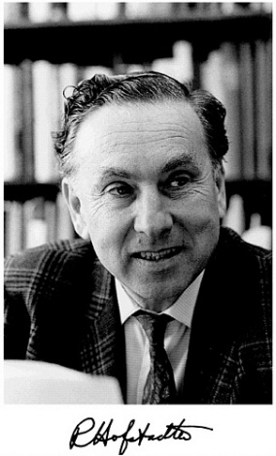
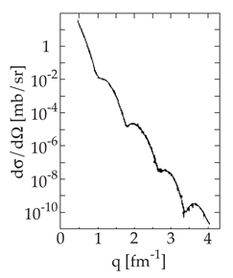
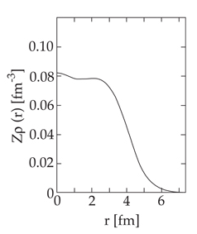


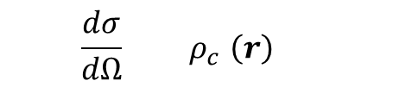

Nuclear charge density, charge radius: the Hofstädter experiment
Result for 450 MeV electron scattering on ⁵⁸Ni (1957):
Woods-Saxon distribution
≡R
$${\frac{dσ}{dΩ} { ρ}_{c} \left(r\right) }_{}$$
$$R_{nucleus}=r_{0}A^{1/3}$$

Slide 40
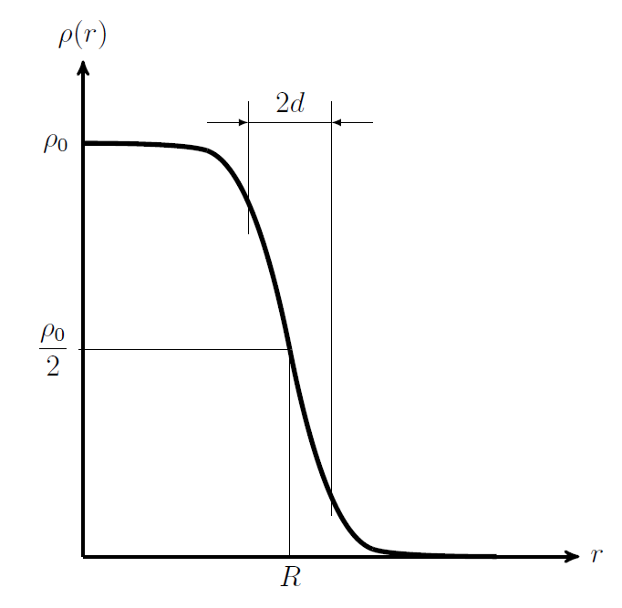
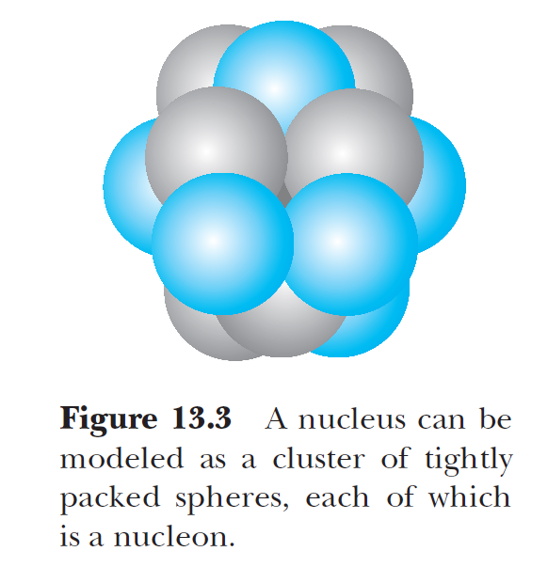


Nuclear charge density, charge radius: the Hofstädter experiment
Woods-Saxon distribution
≡R
The smaller the „d” the closer we get to homogeneous charge distribution
$$R_{nucleus}=r_{0}A^{1/3}$$
Density independent of A
Good approximation over a large region of the nucleus; diviation around R
Notes:
Nucleons cannot get indefinitely close to each other!

Slide 41
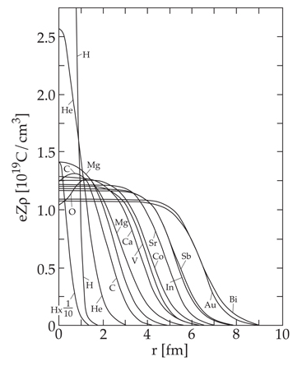
Nuclear charge density, charge radius: the Hofstädter experiment
Measurement for different isotopes:
Woods-Saxon distribution
≡R
The smaller the „d” the closer we get to homogeneous charge distribution
$$R_{nucleus}=r_{0}A^{1/3}$$
Density independent of A
Good approximation over a large region of the nucleus; diviation around R

Slide 42

Nuclear spin and magnetic moment
Nuclear-spin eigenstates:
$$\left.\left|I,M\right.\right\rangle \sim ⊗_{i=1}^{A}\left.\left|j_{i},m_{ji}\right.\right\rangle$$
nucleus
single nucleon total angular momentum eigenstates

Slide 43
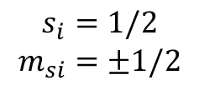
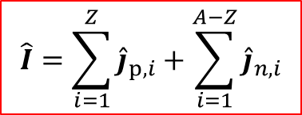





Nuclear spin and magnetic moment
Nuclear-spin eigenstates:
$$\left.\left|I,M\right.\right\rangle \sim ⊗_{i=1}^{A}\left.\left|j_{i},m_{ji}\right.\right\rangle$$
nucleus
single nucleon total angular momentum eigenstates
$$\hat{I}=\sum_{i=1}^{Z}{{\hat{j}}_{p,i}}+\sum_{i=1}^{A−Z}{{\hat{j}}_{n,i}}$$
Nucleus= bound state of protons and neutrons
$$\begin{matrix}I \\ M\end{matrix}$$
Total angular momentum of a single nucleon:
$${\hat{j}}_{p,i}={\hat{L}}_{p,i}+{\hat{S}}_{p,i}$$
angular momentum + intrinsic spin
$$\begin{matrix}j_{i} \\ m_{ji}\end{matrix}$$
$$\begin{matrix}l_{i} \\ m_{i}\end{matrix}$$
$$\begin{matrix}s_{i}=1/2 \\ m_{si}=±1/2\end{matrix}$$
$$l=0,1,2,….$$

Slide 44

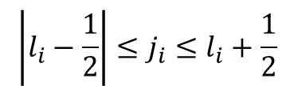
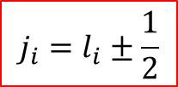
Nuclear spin and magnetic moment
Nuclear-spin eigenstates:
$$\left.\left|I,M\right.\right\rangle \sim ⊗_{i=1}^{A}\left.\left|j_{i},m_{ji}\right.\right\rangle$$
nucleus
single nucleon total angular momentum eigenstates
$$\hat{I}=\sum_{i=1}^{Z}{{\hat{j}}_{p,i}}+\sum_{i=1}^{A−Z}{{\hat{j}}_{n,i}}$$
Nonzero if there are unpaired nucleons
pair: (p,p); (n,n)
For He-4: 2 protons, 2 neutrons I=0
Nucleus= bound state of protons and neutrons
$$\begin{matrix}I \\ M\end{matrix}$$
$${\hat{j}}_{p,i}={\hat{L}}_{p,i}+{\hat{S}}_{p,i}$$
$$\left|l_{i}−\frac{1}{2}\right|≤j_{i}≤l_{i}+\frac{1}{2}$$
Total angular momentum of a single nucleon:
angular momentum + intrinsic spin
$$\begin{matrix}j_{i} \\ m_{ji}\end{matrix}$$
$$\begin{matrix}l_{i} \\ m_{i}\end{matrix}$$
$$\begin{matrix}s_{i}=1/2 \\ m_{si}=±1/2\end{matrix}$$
$$j_{i}=l_{i}±\frac{1}{2}$$

Slide 45
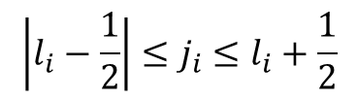
Nuclear spin and magnetic moment
Nuclear-spin eigenstates:
$$\left.\left|I,M\right.\right\rangle \sim ⊗_{i=1}^{A}\left.\left|j_{i},m_{ji}\right.\right\rangle$$
nucleus
single nucleon total angular momentum eigenstates
$$\hat{I}=\sum_{i=1}^{Z}{{\hat{j}}_{p,i}}+\sum_{i=1}^{A−Z}{{\hat{j}}_{n,i}}$$
Nonzero if there are unpaired nucleons
pair: (p,p); (n,n)
For He-4: 2 protons, 2 neutrons I=0
Nucleus= bound state of protons and neutrons
$$\begin{matrix}I \\ M\end{matrix}$$
$${\hat{j}}_{p,i}={\hat{L}}_{p,i}+{\hat{S}}_{p,i}$$
$$\left|l_{i}−\frac{1}{2}\right|≤j_{i}≤l_{i}+\frac{1}{2}$$
Total angular momentum of a single nucleon:
angular momentum + intrinsic spin
$$j_{i}=l_{i}±\frac{1}{2}$$
Nuclear spin I is a constant of motion; it is a fixed, measurable quantity for a nucleus!

Slide 46
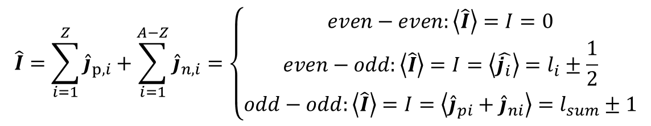
Nuclear spin and magnetic moment
Nuclear-spin eigenstates:
$$\left.\left|I,M\right.\right\rangle \sim ⊗_{i=1}^{A}\left.\left|j_{i},m_{ji}\right.\right\rangle$$
nucleus
single nucleon total angular momentum eigenstates
Identical nucleons organize into j=0 pairs!
$$\hat{I}=\sum_{i=1}^{Z}{{\hat{j}}_{p,i}}+\sum_{i=1}^{A−Z}{{\hat{j}}_{n,i}}=\left\{\begin{matrix}even−even:\left\langle \hat{I}\right\rangle =I=0 \\ even−odd:\left\langle \hat{I}\right\rangle =I=\left\langle \hat{j_{i}}\right\rangle =l_{i}±\frac{1}{2} \\ odd−odd:\left\langle \hat{I}\right\rangle =I=\left\langle {\hat{j}}_{pi}+{\hat{j}}_{ni}\right\rangle =l_{sum}±1\end{matrix}\right.$$
0
half-integer
integer
Nuclear spin I is a constant of motion; it is a fixed, measurable quantity for a nucleus!

Slide 47



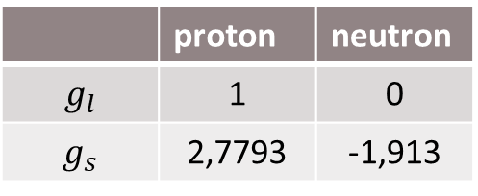
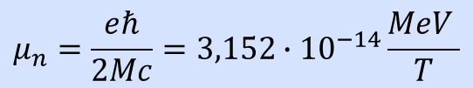


Nuclear spin and magnetic moment
$$μ_{l}=g_{l}μ_{n}L$$
Angular moment generates it
Net magnetic dipole moment for a nucleon:
Magnetic dipole moment of a positively charged current loop:
$$μ_{j}=g_{l}μ_{n}L+2g_{s}μ_{n}S$$
$$μ_{s}={2g}_{s}μ_{n}S$$
Intrinsic spin generates it
 | proton | neutron
$$g_{l}$$ | 1 | 0
$$g_{s}$$ | 2,7793 | -1,913
Bohr magneton
$$μ_{n}=\frac{eℏ}{2Mc}=3,152∙{10}^{−14}\frac{MeV }{T}$$

Slide 48
Nuclear spin and magnetic moment
$$μ_{l}=g_{l}μ_{n}L$$
Angular momentum generates it
Net magnetic dipole moment for a nucleon:
$$μ_{j}=g_{l}μ_{n}L+2g_{s}μ_{n}S$$
$$μ_{s}={2g}_{s}μ_{n}S$$
Intrinsic spin generates it
 | proton | neutron
$$g_{l}$$ | 1 | 0
$$g_{s}$$ | 2,7793 | -1,913
Negative sign indicates the opposite direction of the magnetic moment vector to the spin!
It was a mystery!
Nucleons shall have an internal structure!
$$μ_{n}=\frac{eℏ}{2Mc}=3,152∙{10}^{−14}\frac{MeV }{T}$$

Slide 49

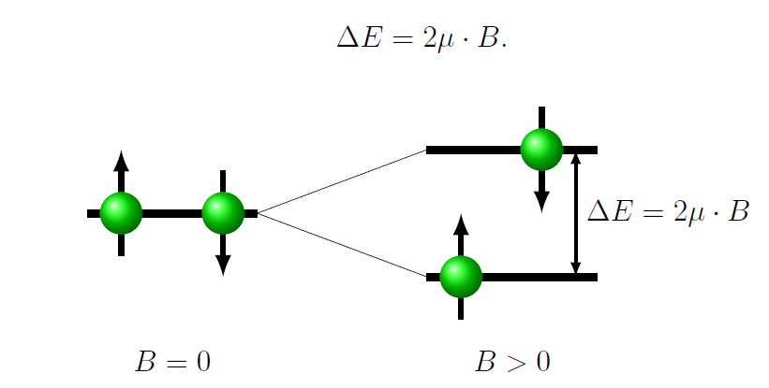

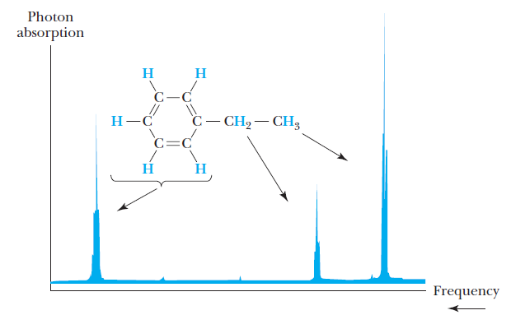
Magnetic moment of nucleons and NMR (nuclear magnetic resonance)
a constant field B
Interaction with external magnetic field
energy difference between the possible spin states due to the external field
+ an oscillating magnetic field
proton NMR
the magnetic field the proton interacts with depends on the molecular enviornment
ΔE transition: absorbing and emitting photons
nuclear magnetic resonance imaging NMR
energy level splitting according to spin due to external magnetic field
Notes:
The basic idea behind mangetic resonance imaging technics is based on the nuclear magnetic moment. Eg. What happens in proton NMR

Slide 50
Nuclear force and nuclear models
Binding energy, Weiszäcker formula, Nuclear stability

Slide 51

Nuclear binding energy
Mass of the nucleus?
$$M\left(A,Z\right)=Z∙m_{p}+(A−Z)∙m_{n}$$
mass of its constituents?

Slide 52

Nuclear binding energy
Mass of the nucleus?
$$M\left(A,Z\right)=Z∙m_{p}+(A−Z)∙m_{n}$$
mass of its constituents?
NO
Experience suggests:
$$M\left(A,Z\right)<Z∙m_{p}+(A−Z)∙m_{n}$$
Mass defect!
Free nucleons are heavier…
Where does the difference originate from? The strong nuclear force!

Slide 53
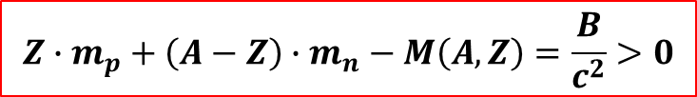
Nuclear binding energy
Mass of the nucleus?
$$M\left(A,Z\right)=Z∙m_{p}+(A−Z)∙m_{n}$$
mass of its constituents?
NO
Experience suggests:
$$M\left(A,Z\right)<Z∙m_{p}+(A−Z)∙m_{n}$$
Mass defect!
Free nucleons are heavier…
Where does the difference originate from? The strong nuclear force!
Binding energy:
the energy required to separate the nucleus into free neutrons and protons.
$$Z∙m_{p}+\left(A−Z\right)∙m_{n}−M\left(A,Z\right)=\frac{B}{c^{2}}>0$$
MeV scale!
Compare: electron binding energy in hydrogen

Slide 54
Nuclear binding energy
Mass of the nucleus?
$$M\left(A,Z\right)=Z∙m_{p}+(A−Z)∙m_{n}$$
mass of its constituents?
NO
Experience suggests:
$$M\left(A,Z\right)<Z∙m_{p}+(A−Z)∙m_{n}$$
Mass defect!
Free nucleons are heavier…
Where does the difference originate from? The strong nuclear force!
Binding energy:
the energy required to separate the nucleus into free neutrons and protons.
$$Z∙m_{p}+\left(A−Z\right)∙m_{n}−M\left(A,Z\right)=\frac{B}{c^{2}}>0$$
MeV scale!
Compare: electron binding energy in hydrogen 13,6 eV…
For deuteron (p+n): 2,2 MeV
Notes:
The atomic ionization energies range from a couple of 10 eV-s to a 10 keV

Slide 55
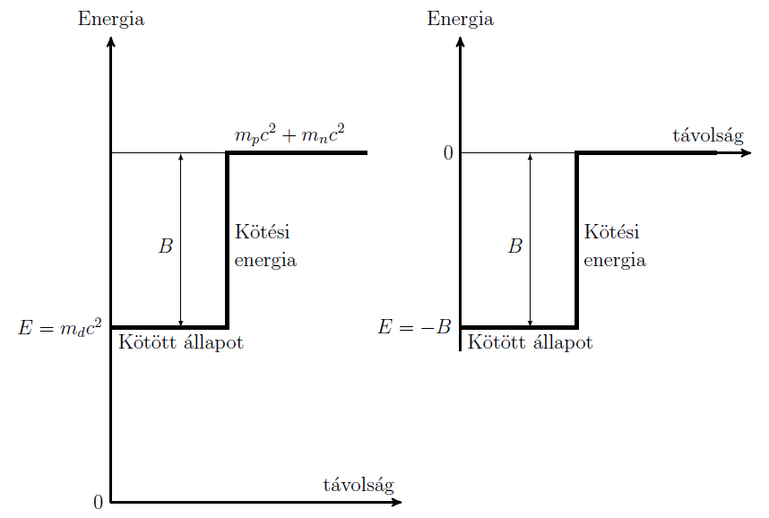

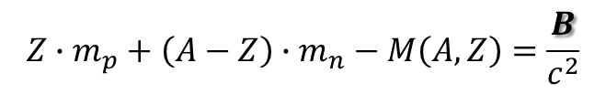
Nuclear binding energy
Indicates a new energy scale convention:
energy
energy
!
Free system E > 0
distance
$E=−B<0$
Binding energy
Binding energy
Bound system E < 0
E: total energy of the nucleus
Bound state
Bound state
$$Z∙m_{p}+\left(A−Z\right)∙m_{n}−M\left(A,Z\right)=\frac{B}{c^{2}}$$
distance
binding energy can be determined by measuring the mass of the nucleus

Slide 56
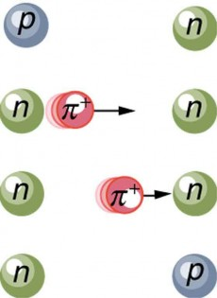


Nuclear force
What could account for the nuclear force?
Virtual particle emission and absorption
Realm of quantum field theory
Nucleons are interacting through a third „inner” particle
Inside the nucleus; one nucleon emits it, the other absorbs it
Cannot be detected
Energy conservation is violated for a Δt amount of time upon a ΔE amount of energy
m: mass of the virtual particle
d_{max} is the maximum range of the nuclear force!
inversely proportional to the mass of the exchange particle
infinite range corresponds to zero-mass force carrier particle – photon for EM interaction!

Slide 57

What do we know about the nucleus so far?
The nuclear force:
Other properties of the nucleus:
Attractive nuclear force dominating the Coulomb force inside the nucleus
Short-range
Independent of the electric charge; „charge-blind” (does not differentiate between protons and neutrons nucleons!)
Density is independent of the mass number: uncompressable nucleus
Approximately constant density inside the nucleus
Radius-mass number relation:
$$R_{nucleus}=r_{0}A^{1/3}$$
Need models to estimate binding energies and understand the nuclear force

Slide 58
The liquid drop model
(Weiszäcker formula)
Uncompressable
Short-range, attractive force
Nucleus
Nuclear force between nucleons
Liquid drop
Van der Waals force between molecules

Slide 59
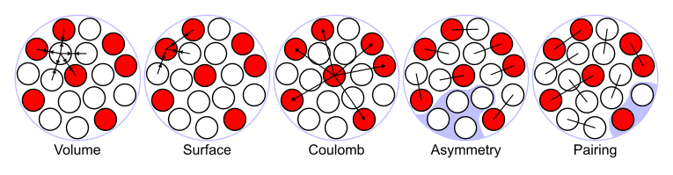

The liquid drop model
(Weiszäcker formula)
Uncompressable
Short-range, attractive force
Nucleus
Nuclear force between nucleons
Liquid drop
Van der Waals force between molecules
$$e_{p}δA^{4/3}$$
Notes:
Every nucleon only feels the attractive force of the surrounding nucleons

Slide 60
The liquid drop model
(Weiszäcker formula)
Uncompressable
Short-range, attractive force
Nucleus
Nuclear force between nucleons
Liquid drop
Van der Waals force between molecules
$$e_{p}δA^{4/3}$$
Negative terms strengthen the binding!
Proper liquid drop

Slide 61
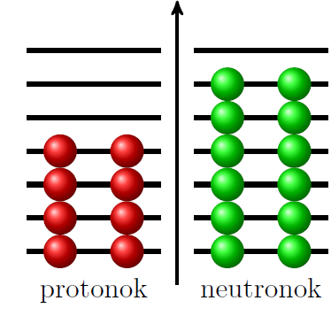

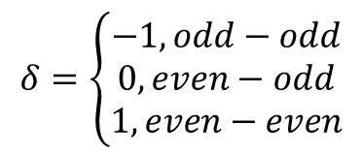
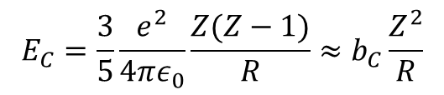
The liquid drop model
(Weiszäcker formula)
Coulomb energy of the nucleus (homogeneous charge distribution; every proton experiences the repulsive force of (Z-1) protons)
Empirical result: identical nucleons organize into pairs
$$δ=\left\{\begin{matrix}−1, odd−odd \\ 0, even−odd \\ 1, even−even\end{matrix}\right.$$
$$E_{C}=\frac{3}{5}\frac{e^{2}}{4πε_{0}}\frac{Z(Z−1)}{R}≈b_{C}\frac{Z^{2}}{R}$$
$$E_{p}=e_{p}δA^{4/3}$$
For identical fermions: Pauli principle!

Slide 62
The liquid drop model
(Weiszäcker formula)
Quantum mechanics!
Coulomb energy of the nucleus (homogeneous charge distribution; every proton experiences the repulsive force of (Z-1) protons)
Empirical result: identical nucleons organize into pairs
$$δ=\left\{\begin{matrix}−1, odd−odd \\ 0, even−odd \\ 1, even−even\end{matrix}\right.$$
$$E_{C}=\frac{3}{5}\frac{e^{2}}{4πε_{0}}\frac{Z(Z−1)}{R}≈b_{C}\frac{Z^{2}}{R}$$
$$E_{p}=e_{p}δA^{4/3}$$
For identical fermions: Pauli principle!
Notes:
When a nucleus strives to minimize its energy it wants to avoid neutron or proton excess

Slide 63
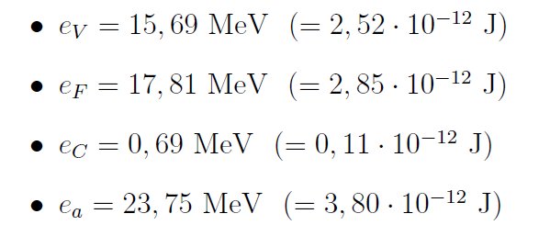

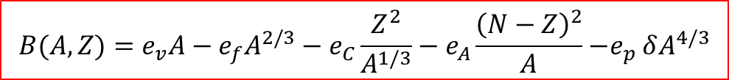


The liquid drop model
(Weiszäcker formula)
$$B(A,Z)=e_{v}A−e_{f}A^{2/3}−e_{C}\frac{Z^{2}}{A^{1/3}}−e_{A}\frac{{\left(N−Z\right)}^{2}}{A}{−e}_{p}δA^{4/3}$$
Remember:
$$R_{nucleus}=r_{0}A^{1/3}$$
$E=−B<0$
The constanst are determined by fitting on empirical data.
The simplest model of the nucleus, although the binding energies of almost all the 2000 nuclei are estimated by this with 1-2% precision.
Higher mass number isotopes are estimated more precisely.

Slide 64

Single particle models: introduction
Coulomb barrier
Liquid drop model captures the general trends of nuclei
  There are strange nuclei which do not obey those trends….
  MAGIC NUCLEI: unusually stable nuclei (the noble gases of nuclei)
Introduce the shell model picture: Goeppert-Mayer and Jensen
  every nucleon exists in a quantized energy state – as in moves in a well-defined orbital in the average field of the other nucleons
  analogy to atomic shells, only the force is different; different even between different kind of nucleons (attractive part + Coulomb)
  Allowable states are filled according to the Pauli principle
  Successfully predicts the magic numbers: 2, 8, 20, 28, 50, 82, 126
closed shells
Notes:
It is the first attempt to understand the nuclear fine structure

Slide 65


Slide 66




Independent particle shell model: fundamentals
j=l+1/2
Solve the Schrödinger equation with central potential in 3D (next semester)
j=l-1/2
Mean-field potential: one nucleon moves in this „fixed” potential independently of the other nucleons; this is the average field of the nucleons
harmonic oscillator or Woods-Saxon potential
the nuclear potential is a complicated result of inter-nucleon interactions
the quantum numbers
WS:
r
Notes:
The result of the mutual interactions between all nulceons

Slide 67







Nuclear charge density, charge radius
$${ρ_{c} \left(r\right)→V}_{c}\left(r\right) →\frac{dσ}{dΩ}$$
Relativistic electron scattering on Coulomb potential: Mott scattering (quantum electrodynamics)
Scattering amplitude for pointlike scatterer: can be calculated
$$\frac{dσ}{dΩ}={\left|A_{a}\left(θ\right)\right|}^{2}{\left|F\left(q\right)\right|}^{2}$$
For finite-size nucleus
Momentum transfer: q= p-p’
  high q means large $θ$
$$F\left(q\right)=\int{ρ(r)e^{iqr}d^{3}r}$$
The form factor: Fourier transform of the charge density!
Method: measure
$$\frac{dσ}{dΩ}$$
$$F\left(q\right)$$
Inverse Fourier
transformation:
$$ρ\left(r\right)$$

Slide 68



Nuclear charge density, charge radius
$${ρ_{c} \left(r\right)→V}_{c}\left(r\right) →\frac{dσ}{dΩ}$$
Scattering amplitude for pointlike scatterer
$$\frac{dσ}{dΩ}={\left|A_{a}\left(θ\right)\right|}^{2}{\left|F\left(q\right)\right|}^{2}$$
$$F\left(q\right)=\int{ρ(r)e^{iqr}d^{3}r}$$
superposition of elementary scatterings
Method: measure
$$\frac{dσ}{dΩ}$$
$$F\left(q\right)$$
Inverse Fourier
transformation:
$$ρ\left(r\right)$$

Slide 69








Nuclear spin and magnetic moment
Nuclear-spin eigenstates:
$$\left.\left|I,M\right.\right\rangle \sim ⊗_{i=1}^{A}\left.\left|j_{i},m_{ji}\right.\right\rangle$$
nucleus
single nucleon total angular momentum eigenstates
*Supplementary material:
Addition of angular momenta:
$$\hat{I}={\hat{L}}_{1}+{\hat{L}}_{2}$$
express the addition of two angular momenta in terms of a third:
$$\left.\left|I,M\right.\right\rangle =\sum_{m_{1}m_{2}}{\left.\left|l_{1}l_{2},m_{1}m_{2}\right.\right\rangle \left\langle l_{1}l_{2},m_{1}m_{2} | I,M\right\rangle }$$
$$\begin{matrix}I \\ M\end{matrix}$$
$$\begin{matrix}l_{1} \\ m_{1}\end{matrix}$$
$$\begin{matrix}l_{2} \\ m_{2}\end{matrix}$$
$$\left.\left|l_{1},m_{1}\right.\right\rangle ⨂\left.\left|l_{2},m_{2}\right.\right\rangle$$
Clebsch-Gordan
Coeff., (angular momentum conservation)
Summation rules:
$$\left|l_{1}−l_{2}\right|≤I≤l_{1}+l_{2}$$
$$M=m_{1}+m_{2}$$

Slide 70














Nuclear spin and magnetic moment
$$μ_{l}=g_{l}μ_{n}L$$
 | proton | neutron
$$g_{l}$$ | 1 | 0
$$g_{s}$$ | 2,7793 | -1,913
Total magnetic dipole moment for a nucleon:
$$μ_{j}=g_{l}μ_{n}L+2g_{s}μ_{n}S$$
$$μ_{s}={2g}_{s}μ_{n}S$$
$$μ_{n}=\frac{eℏ}{2Mc}=3,152∙{10}^{−14}\frac{MeV }{T}$$
$$μ_{nucleus}=μ_{j,odd}=g_{l}μ_{n}L+2g_{s}μ_{n}S$$
for even-odd nuclei
$$μ_{l}$$
$$\hat{I}$$
$${\hat{L}}_{i}$$
$$\hat{I}$$
$$μ_{n}$$
$$μ_{n}$$
Attention: is not a constant of motion!
$${\hat{S}}_{i}$$
$$μ_{s}$$

